Slide 1
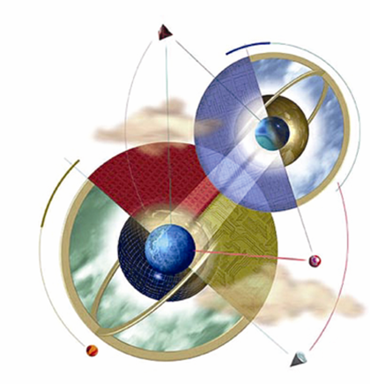
EXPERT SYSTEMS
S. TSWANE

Slide 2
OBJECTIVES
Learn the meaning of an expert system
Understand the problem domain and knowledge domain
Learn the advantages of an expert system
Understand the stages in the development of an expert system
Examine the general characteristics of an expert system

Slide 3
OBJECTIVES
Examine earlier expert systems which have given rise to today’s knowledge-based systems
Explore the applications of expert systems in use today
Examine the structure of a rule-based expert system
Learn the difference between procedural and nonprocedural paradigms
What are the characteristics of artificial neural systems

Slide 4
WHAT IS AN EXPERT SYSTEM?
“An expert system is a computer system that emulates, or acts in all respects, with the decision-making capabilities of a human expert.”
Professor Edward Feigenbaum
Stanford University
Can be considered declarative languages:
Programmer does not specify how to achieve a goal at the algorithm level.
Induction-based programming – the program learns by generalizing from a sample.
Notes:
What is an Expert System?
An expert system is a computer program that is designed to solve complex problems and to provide decision-making ability like a human expert. It performs this by extracting knowledge from its knowledge base using the reasoning and inference rules according to the user queries.
The expert system is a part of AI, and the first ES was developed in the year 1970, which was the first successful approach of artificial intelligence. It solves the most complex issue as an expert by extracting the knowledge stored in its knowledge base. The system helps in decision making for complex problems using both facts and heuristics like a human expert. It is called so because it contains the expert knowledge of a specific domain and can solve any complex problem of that particular domain. These systems are designed for a specific domain, such as medicine, science, etc.
The performance of an expert system is based on the expert's knowledge stored in its knowledge base. The more knowledge stored in the KB, the more that system improves its performance. One of the common examples of an ES is a suggestion of spelling errors while typing in the Google search box.

Slide 5
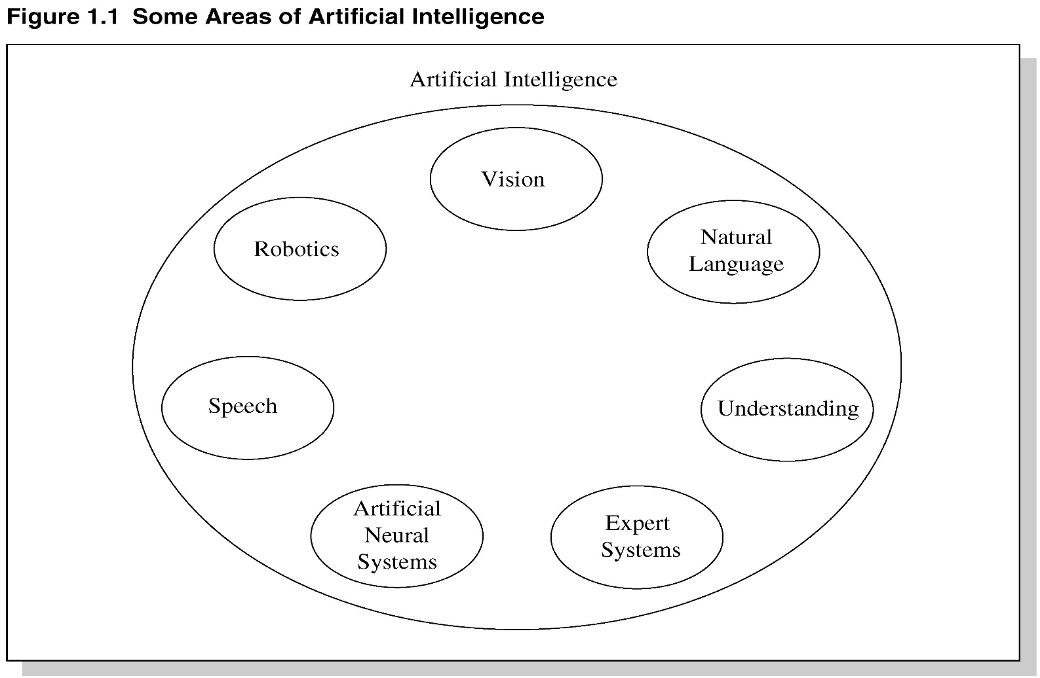
AREAS OF ARTIFICIAL INTELLIGENCE

Slide 6
EXPERT SYSTEM TECHNOLOGY
MAY INCLUDE:
Special expert system languages – CLIPS
Programs
Hardware designed to facilitate the implementation of those systems
Notes:
There are several levels of ES technologies available. Two important things to keep in mind when selecting ES tools include:
1. The tool selected for the project has to match the capability and sophistication of the projected ES, in particular, the need to integrate it with other subsystems such as databases and other components of a larger information system.
2. The tool also has to match the qualifications of the project team.
Expert systems technologies include:
1. Specific expert systems
- These expert systems actually provide recommendations in a specific task domain.
2. Expert system shells
- are the most common vehicle for the development of specific ESs. A shell is an expert system without a knowledge base. A shell furnishes the ES developer with the inference engine, user interface, and the explanation and knowledge acquisition facilities.
Domain-specific shells are actually incomplete specific expert systems, which require much less effort in order to field an actual system.
3. Expert system development environments
- these systems expand the capabilities of shells in various directions. They run on engineering workstations, minicomputers, or mainframes; offer tight integration with large databases; and support the building of large expert systems.
4. High-level programming languages
Several ES development environments have been rewritten from LISP into a procedural language more commonly found in the commercial environment, such as C or C++. ESs are now rarely developed in a programming language.

Slide 7
EXPERT SYSTEM MAIN COMPONENTS
Interface – helps a non-expert user to communicate with the expert system to find a solution.
Knowledge base – obtainable from books, magazines, knowledgeable persons, etc.
Inference engine – draws conclusions from the knowledge base
Notes:
User Interface
With the help of a user interface, the expert system interacts with the user, takes queries as an input in a readable format, and passes it to the inference engine. After getting the response from the inference engine, it displays the output to the user. In other words, it is an interface that helps a non-expert user to communicate with the expert system to find a solution.
Inference Engine(Rules of Engine)
The inference engine is known as the brain of the expert system as it is the main processing unit of the system. It applies inference rules to the knowledge base to derive a conclusion or deduce new information. It helps in deriving an error-free solution of queries asked by the user.
With the help of an inference engine, the system extracts the knowledge from the knowledge base.
There are two types of inference engine:
Deterministic Inference engine: The conclusions drawn from this type of inference engine are assumed to be true. It is based on facts and rules.
Probabilistic Inference engine: This type of inference engine contains uncertainty in conclusions, and based on the probability.
Inference engine uses the below modes to derive the solutions:
Forward Chaining: It starts from the known facts and rules, and applies the inference rules to add their conclusion to the known facts.
Backward Chaining: It is a backward reasoning method that starts from the goal and works backward to prove the known facts.
3. Knowledge Base
The knowledgebase is a type of storage that stores knowledge acquired from the different experts of the particular domain. It is considered as big storage of knowledge. The more the knowledge base, the more precise will be the Expert System.
It is similar to a database that contains information and rules of a particular domain or subject.
One can also view the knowledge base as collections of objects and their attributes. Such as a Lion is an object and its attributes are it is a mammal, it is not a domestic animal, etc.

Slide 8
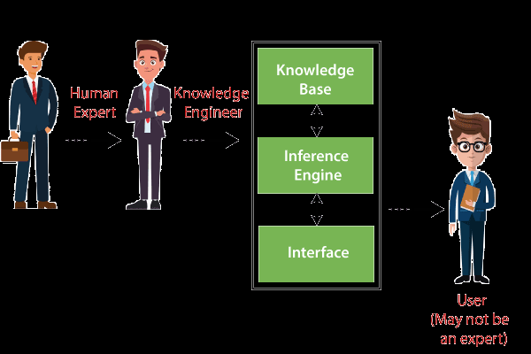
BASIC FUNCTIONS
OF EXPERT SYSTEMS
Expert System

Slide 9
PROBLEM DOMAIN VS. KNOWLEDGE DOMAIN
An expert’s knowledge is specific to one problem domain – medicine, finance, science, engineering, etc.
The expert’s knowledge about solving specific problems is called the knowledge domain.
The problem domain is always a superset of the knowledge domain.

Slide 10
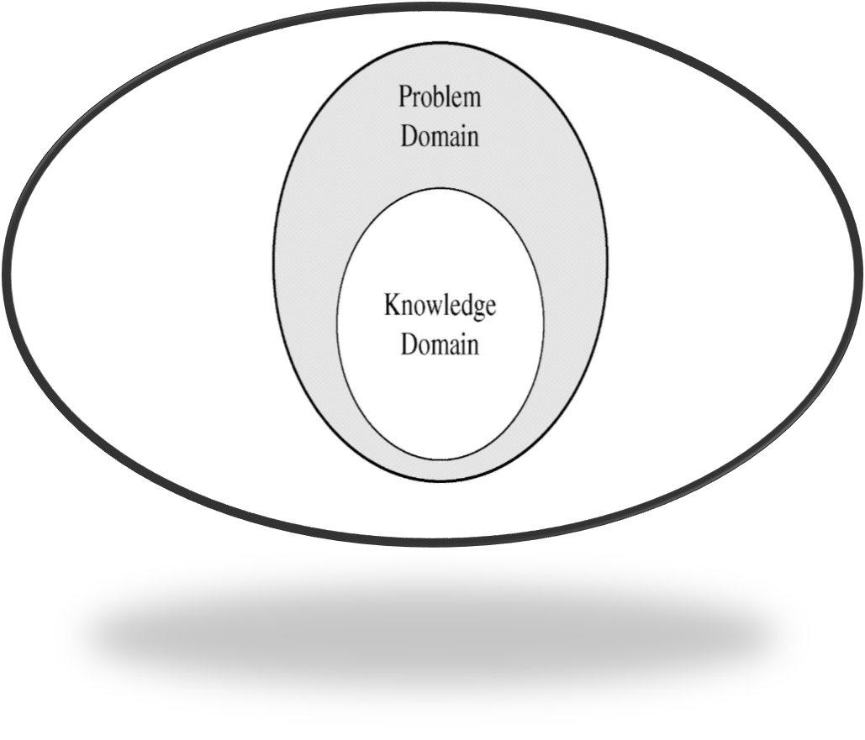
PROBLEM AND KNOWLEDGE DOMAIN RELATIONSHIP

Slide 11
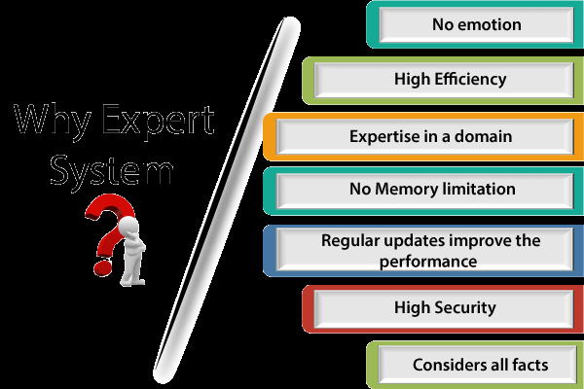
WHY EXPERT SYSTEMS?
Notes:
Before using any technology, we must have an idea about why to use that technology and hence the same for the ES. Although we have human experts in every field, then what is the need to develop a computer-based system. So below are the points that are describing the need of the ES:
No memory Limitations: It can store as much data as required and can memorize it at the time of its application. But for human experts, there are some limitations to memorize all things at every time.
High Efficiency: If the knowledge base is updated with the correct knowledge, then it provides a highly efficient output, which may not be possible for a human.
Expertise in a domain: There are lots of human experts in each domain, and they all have different skills, different experiences, and different skills, so it is not easy to get a final output for the query. But if we put the knowledge gained from human experts into the expert system, then it provides an efficient output by mixing all the facts and knowledge
Not affected by emotions: These systems are not affected by human emotions such as fatigue, anger, depression, anxiety, etc.. Hence the performance remains constant.
High security: These systems provide high security to resolve any query.
Considers all the facts: To respond to any query, it checks and considers all the available facts and provides the result accordingly. But it is possible that a human expert may not consider some facts due to any reason.
Regular updates improve the performance: If there is an issue in the result provided by the expert systems, we can improve the performance of the system by updating the knowledge base.
Capabilities of the Expert System

Slide 12
ADVANTAGES OF EXPERT SYSTEMS
Increased availability
Reduced cost
Reduced danger
Performance
Multiple expertise
Increased reliability
Explanation
Fast response
Steady, unemotional, and complete responses at all times
Intelligent tutor
Intelligent database

Slide 13
LIMITATIONS OF EXPERT SYSTEMS
The response of the expert system may get wrong if the knowledge base contains the wrong information.
Like a human being, it cannot produce a creative output for different scenarios.
Its maintenance and development costs are very high.
Knowledge acquisition for designing is much difficult.
For each domain, we require a specific ES, which is one of the big limitations.
It cannot learn from itself and hence requires manual updates.
Notes:
. Not widely used or tested
. Limited to relatively narrow problems
. Cannot readily deal with “mixed” knowledge
. Possibility of error
. Cannot refine own knowledge
. Difficult to maintain
. May have high development costs
. Raise legal and ethical concerns

Slide 14
REPRESENTING THE KNOWLEDGE
The knowledge of an expert system can be represented in a number of ways, including IF-THEN rules:
IF you are hungry THEN eat

Slide 15
KNOWLEDGE ENGINEERING
The process of building an expert system:
The knowledge engineer establishes a dialog with the human expert to elicit knowledge.
The knowledge engineer codes the knowledge explicitly in the knowledge base.
The expert evaluates the expert system and gives a critique to the knowledge engineer.
Notes:
Participants in the development of Expert System
There are three primary participants in the building of Expert System:
Expert: The success of an ES much depends on the knowledge provided by human experts. These experts are those persons who are specialized in that specific domain.
Knowledge Engineer: Knowledge engineer is the person who gathers the knowledge from the domain experts and then codifies that knowledge to the system according to the formalism.
End-User: This is a particular person or a group of people who may not be experts, and working on the expert system needs the solution or advice for his queries, which are complex.
1. Expert - Successful ES systems depend on the experience and application of knowledge that the people can bring to it during its development. Large systems generally require multiple experts.
2. Knowledge engineer - The knowledge engineer has a dual task. This person should be able to elicit knowledge from the expert, gradually gaining an understanding of an area of expertise. Intelligence, tact, empathy, and proficiency in specific techniques of knowledge acquisition are all required of a knowledge engineer. Knowledge-acquisition techniques include conducting interviews with varying degrees of structure, protocol analysis, observation of experts at work, and analysis of cases.
On the other hand, the knowledge engineer must also select a tool appropriate for the project and use it to represent the knowledge with the application of the knowledge acquisition facility.
3. End-User - A system developed by an end user with a simple shell, is built rather quickly an inexpensively. Larger systems are built in an organized development effort. A prototype-oriented iterative development strategy is commonly used. ESs lends themselves particularly well to prototyping.

Slide 16
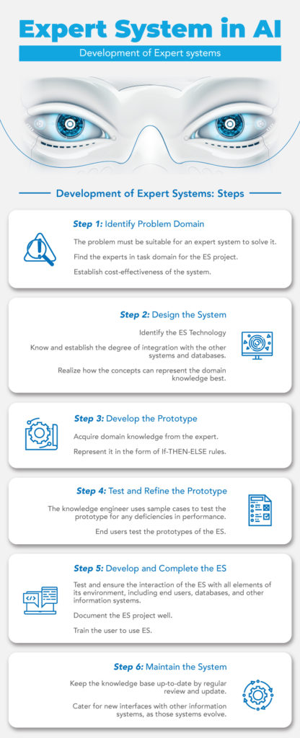
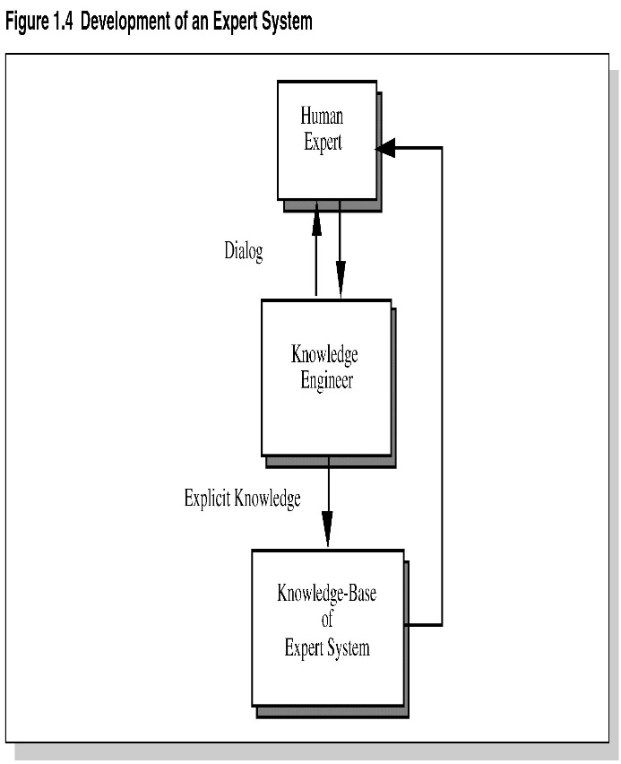
DEVELOPMENT OF AN EXPERT SYSTEM
Notes:
Steps in the methodology for the iterative process of ES development and maintenance include:
1. Problem Identification and Feasibility Analysis:
- the problem must be suitable for an expert system to solve it.
- must find an expert for the project
- cost-effectiveness of the system has to be established (feasibility)
2. System Design and ES Technology Identification:
- the system is being designed. The needed degree of integration with other subsystems and databases is established
- concepts that best represent the domain knowledge are worked out
- the best way to represent the knowledge and to perform inferencing should be established with sample cases
3. Development of Prototype:
- knowledge engineer works with the expert to place the initial kernel of knowledge in the knowledge base.
- knowledge needs to be expressed in the language of the specific tool chosen for the project
4. Testing and Refinement of Prototype:
- using sample cases, the prototype is tested, and deficiencies in performance are noted. End users test the prototypes of the ES.
5. Complete and Field the ES:
- the interaction of the ES with all elements of its environment, including users and other information systems, is ensured and tested.
- ES is documented and user training is conducted
6. Maintain the System:
- the system is keep current primarily by updating its knowledge base.
- interfaces with other information systems have to be maintained as well, as those systems evolve.

Slide 17
THE ROLE OF AI
An algorithm is an ideal solution guaranteed to yield a solution in a finite amount of time.
When an algorithm is not available or is insufficient, we rely on artificial intelligence (AI).
Expert system relies on inference – we accept a “reasonable solution.”

Slide 18
UNCERTAINTY
Both human experts and expert systems must be able to deal with uncertainty.
It is easier to program expert systems with shallow knowledge than with deep knowledge.
Shallow knowledge – based on empirical and heuristic knowledge.
Deep knowledge – based on basic structure, function, and behavior of objects.
Notes:
Uncertainty and Fuzzy Logic
Fuzzy logic is a method of reasoning that resembles human reasoning since it allows for approximate values and inferences and incomplete or ambiguous data (fuzzy data). Fuzzy logic is a method of choice for handling uncertainty in some expert systems.
Expert systems with fuzzy-logic capabilities thus allow for more flexible and creative handling of problems. These systems are used, for example, to control manufacturing processes.

Slide 19
EARLY EXPERT SYSTEMS
DENDRAL – used in chemical mass spectroscopy to identify chemical constituents
MYCIN – medical diagnosis of illness
DIPMETER – geological data analysis for oil
PROSPECTOR – geological data analysis for minerals
XCON/R1 – configuring computer systems
Notes:
HERE are some popular examples of the Expert System:
DENDRAL: It was an artificial intelligence project that was made as a chemical analysis expert system. It was used in organic chemistry to detect unknown organic molecules with the help of their mass spectra and knowledge base of chemistry.
MYCIN: It was one of the earliest backward chaining expert systems that was designed to find the bacteria causing infections like bacteraemia and meningitis. It was also used for the recommendation of antibiotics and the diagnosis of blood clotting diseases.
PXDES: It is an expert system that is used to determine the type and level of lung cancer. To determine the disease, it takes a picture from the upper body, which looks like the shadow. This shadow identifies the type and degree of harm.
CaDeT: The CaDet expert system is a diagnostic support system that can detect cancer at early stages.

Slide 20
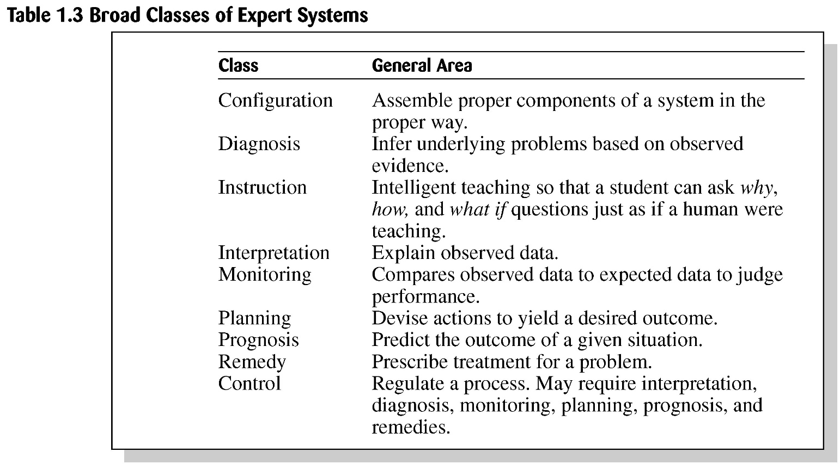
BROAD CLASSES
OF EXPERT SYSTEMS

Slide 21
PROBLEMS WITH ALGORITHMIC SOLUTIONS
Conventional computer programs generally solve problems having algorithmic solutions.
Algorithmic languages include C, Java, and C#.
Classical AI languages include LISP and PROLOG.
Notes:
Algorithmic solutions to a problem are those solutions that aim to solve a problem in a series of steps. For example: To sort an array in increasing order, a sequential order of steps is followed, so this type of solution is an algorithmic solution.
A Real Life Algorithm- One of the most obvious examples of an algorithm is a recipe. It's a finite list of instructions used to perform a task. For example, if you were to follow the algorithm to create brownies from a box mix, you would follow the three to five step process written on the back of the box.
High level symbolic programming languages [LISt Programming (LISP) and PROgrammation en LOGique (PROLOG)], as well as large data bases.

Slide 22
CONSIDERATIONS FOR BUILDING EXPERT SYSTEMS
Can the problem be solved effectively by conventional programming?
Is there a need and a desire for an expert system?
Is there at least one human expert who is willing to cooperate?
Can the expert explain the knowledge to the knowledge engineer can understand it.
Is the problem-solving knowledge mainly heuristic and uncertain?

Slide 23
LANGUAGES, SHELLS, AND TOOLS
Expert system languages are post-third generation.
Procedural languages (e.g., C) focus on techniques to represent data.
More modern languages (e.g., Java) focus on data abstraction.
Expert system languages (e.g. CLIPS) focus on ways to represent knowledge.
Notes:
The ES development environment contains a set of hardware tools (Workstations, minicomputers, mainframes), High level symbolic programming languages [LISt Programming (LISP) and PROgrammation en LOGique (PROLOG)], as well as large data bases.
Tools
Tools, as an ES technology, assists in reducing the effort and cost involved in developing an expert system to a large extent.
Shells
A Shell an expert system that functions without a knowledge base. It provides developers with knowledge acquisition, inference engine, user interface, and explanation facility. For example – Java Expert System Shell (JESS), Vidwan, etc.

Slide 24
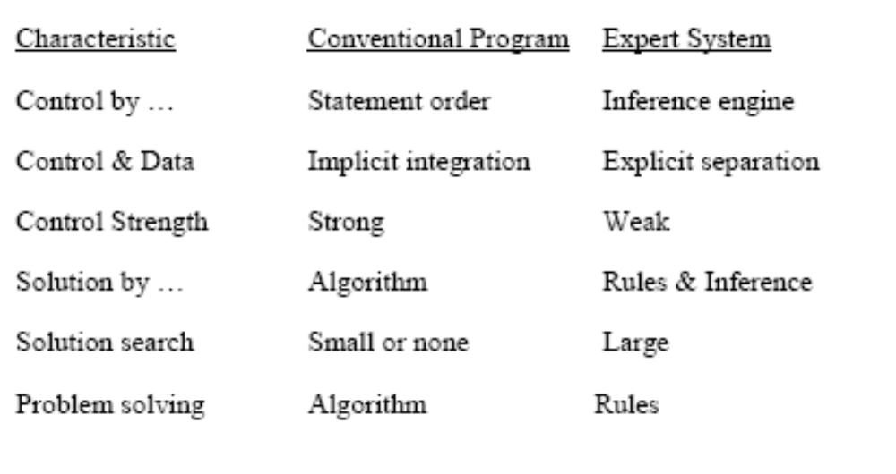
EXPERT SYSTEMS VS CONVENTIONAL PROGRAMS I

Slide 25
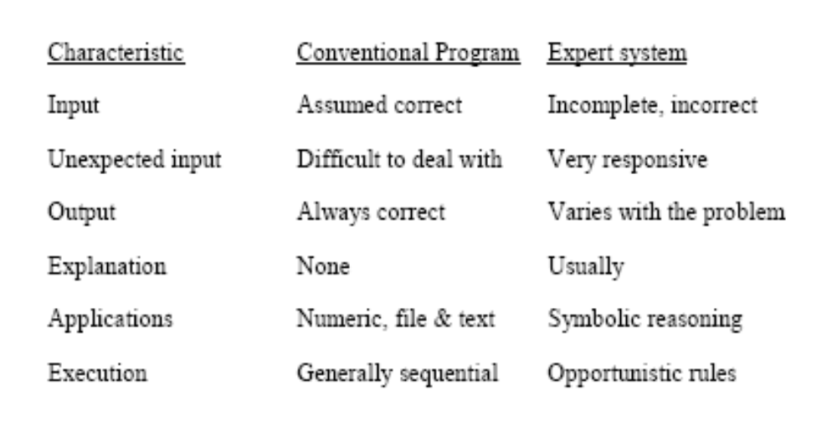
EXPERT SYSTEMS VS CONVENTIONAL PROGRAMS II

Slide 26
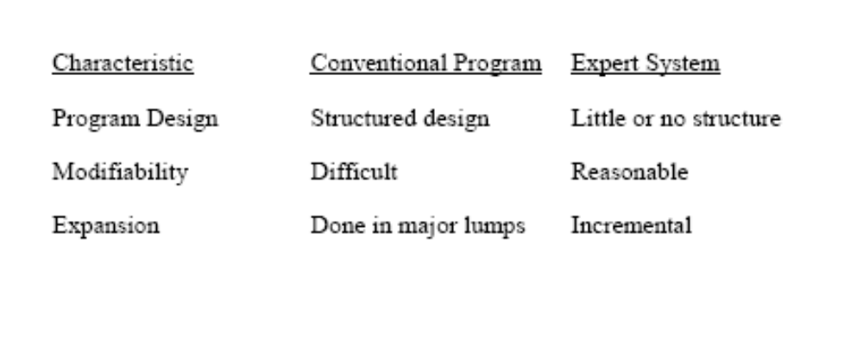
EXPERT SYSTEMS VS CONVENTIONAL PROGRAMS III

Slide 27
ELEMENTS OF AN EXPERT SYSTEM
User interface – mechanism by which user and system communicate.
Exploration facility – explains reasoning of expert system to user.
Working memory – global database of facts used by rules.
Inference engine – makes inferences deciding which rules are satisfied and prioritizing.

Slide 28
ELEMENTS CONTINUED
Agenda – a prioritized list of rules created by the inference engine, whose patterns are satisfied by facts or objects in working memory.
Knowledge acquisition facility – automatic way for the user to enter knowledge in the system bypassing the explicit coding by knowledge engineer.
Knowledge Base – includes the rules of the expert system

Slide 29
PRODUCTION RULES
Knowledge base is also called production memory.
Production rules can be expressed in IF-THEN pseudocode format.
In rule-based systems, the inference engine determines which rule antecedents are satisfied by the facts.
Notes:
Production rules - are the most common method of knowledge representation used in business. Rule-based expert systems are expert systems in which the knowledge is represented by production rules.
A production rule, or simply a rule, consists of an IF part (a condition or premise) and a THEN part (an action or conclusion). IF condition THEN action (conclusion).
The production rules operate on the global database. Each rule usually has a precondition that is either satisfied or not by the global database. If the precondition is satisfied, the rule is usually be applied. The application of the rule changes the database.
Production system or production rule system is a computer program typically used to provide some form of artificial intelligence, which consists primarily of a set of rules about behavior but it also includes the mechanism necessary to follow those rules as the system responds to states of the world.

Slide 30
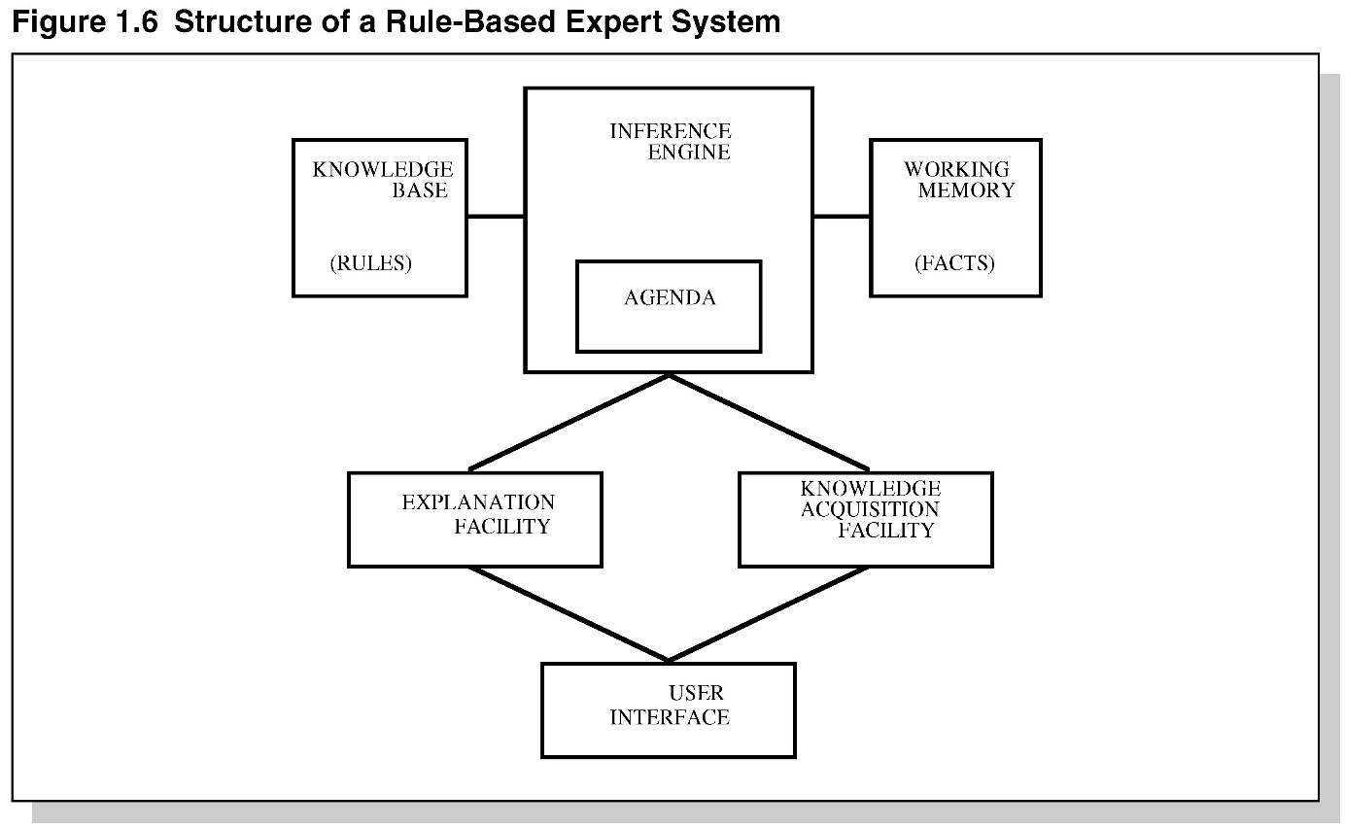
STRUCTURE OF A
RULE-BASED EXPERT SYSTEM

Slide 31
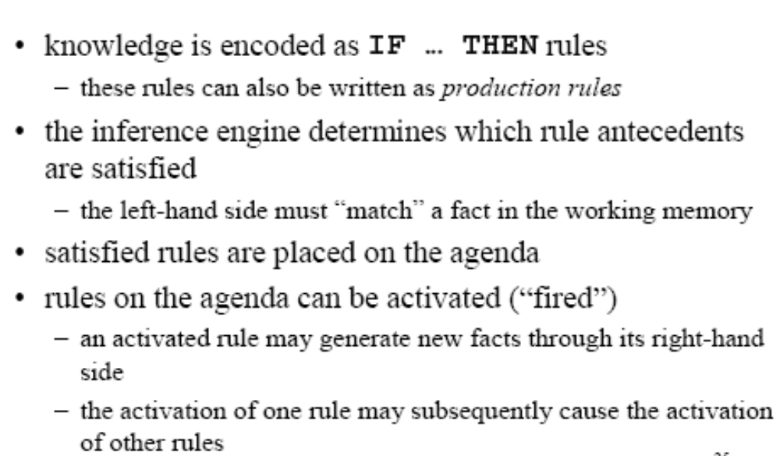
RULE-BASED ES

Slide 32
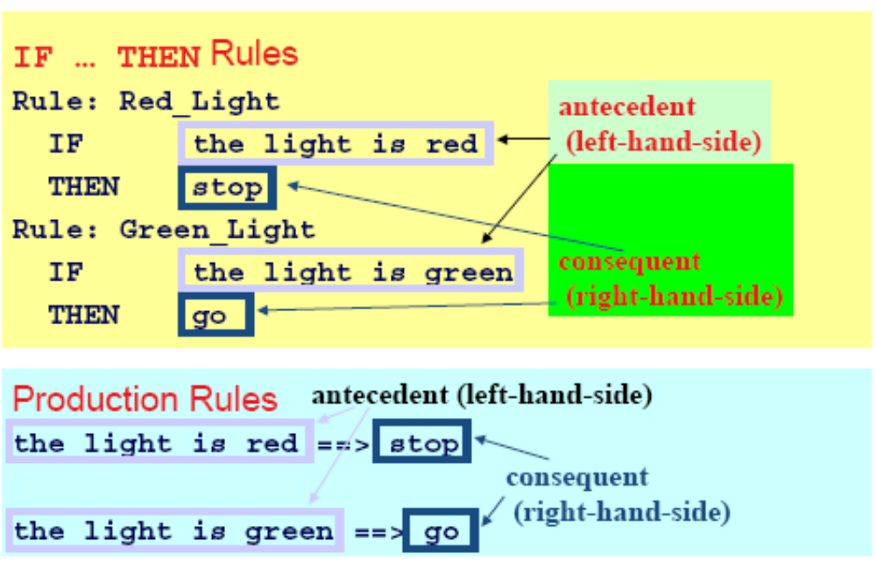
EXAMPLE RULES

Slide 33
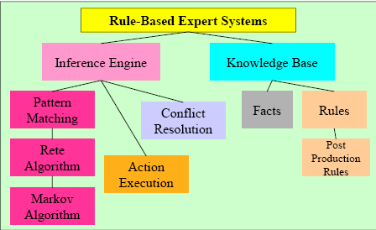
FOUNDATION OF EXPERT SYSTEMS

Slide 34
GENERAL METHODS OF INFERENCING
Forward chaining (data-driven)– reasoning from facts to the conclusions resulting from those facts – best for prognosis, monitoring, and control.
  Examples: CLIPS, OPS5
Backward chaining (query/Goal driven)– reasoning in reverse from a hypothesis, a potential conclusion to be proved to the facts that support the hypothesis – best for diagnosis problems.
  Examples: MYCIN
Notes:
An inference is an idea or conclusion that's drawn from evidence and reasoning. An inference is an educated guess. We learn about some things by experiencing them first-hand, but we gain other knowledge by inference — the process of inferring things based on what is already known.
Forward chaining - begins with input, good if you know the goals from the beginning.
Backward chaining – begins with the goal, implies you know the list of all the goals (or sub goals) and it is a small set.
Forward chaining
- is a data-driven strategy. The inferencing process moves from the facts of the case to a goal (conclusion). The strategy is thus driven by the facts available in the working memory and by the premises that can be satisfied. The inference engine attempts to match the condition (IF) part of each rule in the knowledge base with the facts currently available in the working memory. If several rules match, a conflict resolution procedure is invoked; for example, the lowest-numbered rule that adds new information to the working memory is fired. The conclusion of the firing rule is added to the working memory.
Forward-chaining systems are commonly used to solve more open-ended problems of a design or planning nature, such as, for example, establishing the configuration of a complex product.
2. Backward chaining
- the inference engine attempts to match the assumed (hypothesized) conclusion - the goal or subgoal state - with the conclusion (THEN) part of the rule. If such a rule is found, its premise becomes the new subgoal. In an ES with few possible goal states, this is a good strategy to pursue.
If a hypothesized goal state cannot be supported by the premises, the system will attempt to prove another goal state. Thus, possible conclusions are review until a goal state that can be supported by the premises is encountered.
Backward chaining is best suited for applications in which the possible conclusions are limited in number and well defined. Classification or diagnosis type systems, in which each of several possible conclusions can be checked to see if it is supported by the data, are typical applications.

Slide 35
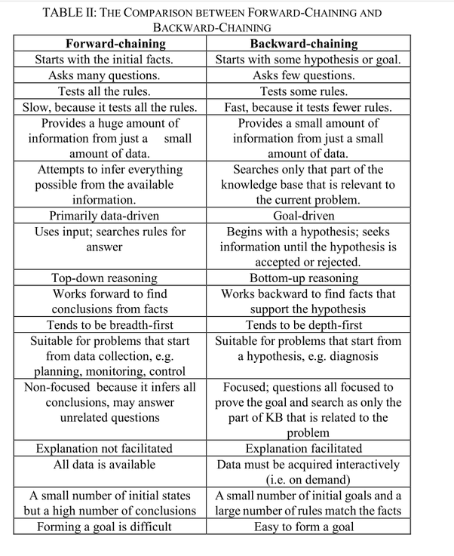

Slide 36
PRODUCTION SYSTEMS
Rule-based expert systems – most popular type today.
Knowledge is represented as multiple rules that specify what should/not be concluded from different situations.
Forward chaining – start w/facts and use rules do draw conclusions/take actions.
Backward chaining – start w/hypothesis and look for rules that allow hypothesis to be proven true.

Slide 37
POST PRODUCTION SYSTEM
Basic idea – any mathematical / logical system is simply a set of rules specifying how to change one string of symbols into another string of symbols.
    these rules are also known as rewrite rules
    simple syntactic string manipulation
    no understanding or interpretation is required\also used to define grammars of languages
      e.g BNF grammars of programming languages.
Basic limitation – lack of control mechanism to guide the application of the rules.

Slide 38
MARKOV ALGORITHM
An ordered group of productions applied in order or priority to an input string.
If the highest priority rule is not applicable, we apply the next, and so on.
inefficient algorithm for systems with many rules.
Termination on (1) last production not applicable to a string, or (2) production ending with period applied
Can be applied to substrings, beginning at left

Slide 39
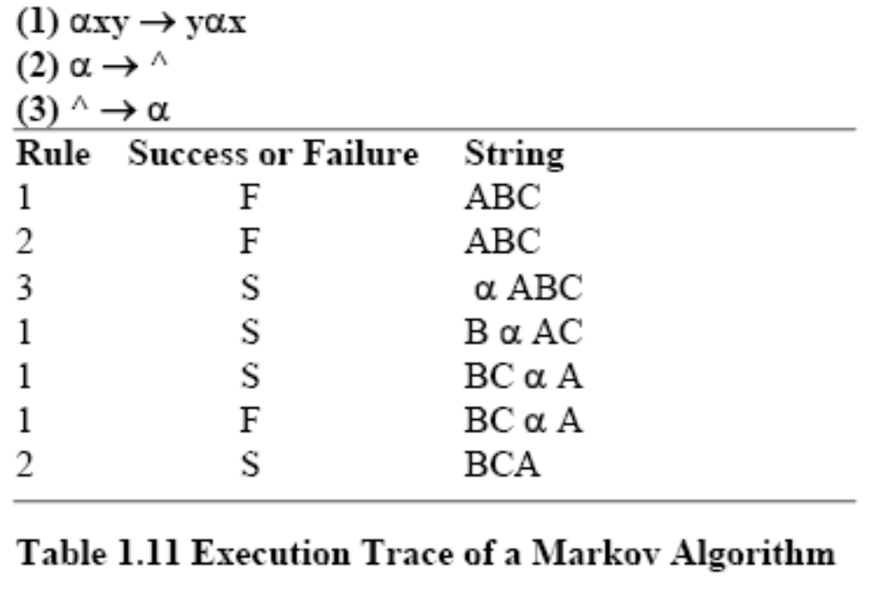
MARKOV ALGORITHM

Slide 40
RETE ALGORITHM
Markov: too inefficient to be used with many rules
Functions like a net – holding a lot of information.
Much faster response times and rule firings can occur compared to a large group of IF-THEN rules which would have to be checked one-by-one in conventional program.
Takes advantage of temporal redundancy and structural similarity.
Looks only for changes in matches (ignores static data)
Drawback is high memory space requirements.

Slide 41
PROCEDURAL PARADIGMS
Algorithm – method of solving a problem in a finite number of steps.
Procedural programs are also called sequential programs.
The programmer specifies exactly how a problem solution must be coded.

Slide 42
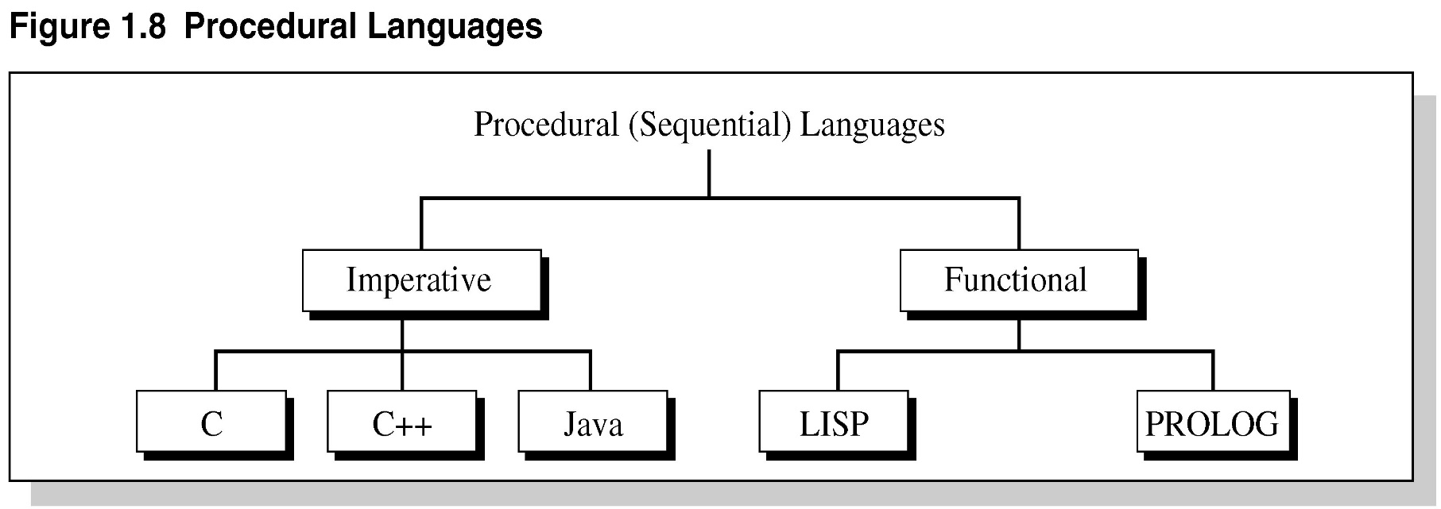
FIGURE 1.8 PROCEDURAL LANGUAGES

Slide 43
IMPERATIVE PROGRAMMING
Also known as statement-oriented
During execution, program makes transition from the initial state to the final state by passing through series of intermediate states.
Provide rigid control and top-down-design.
Not efficient for directly implementing expert systems.

Slide 44
FUNCTIONAL PROGRAMMING
Function-based (association, domain, co-domain); f: S→ T
Not much control
Bottom-up→ combine simple functions to yield more powerful functions.
Mathematically a function is an association or rule that maps members of one set, the domain, into another set, the codomain.
e.g. LISP and Prolog

Slide 45
NONPROCEDURAL PARADIGMS
Do not depend on the programmer giving exact details how the program is to be solved.
Declarative programming – goal is separated from the method to achieve it.
Object-oriented programming – partly imperative and partly declarative – uses objects and methods that act on those objects.
Inheritance – (OOP) subclasses derived from parent classes.

Slide 46
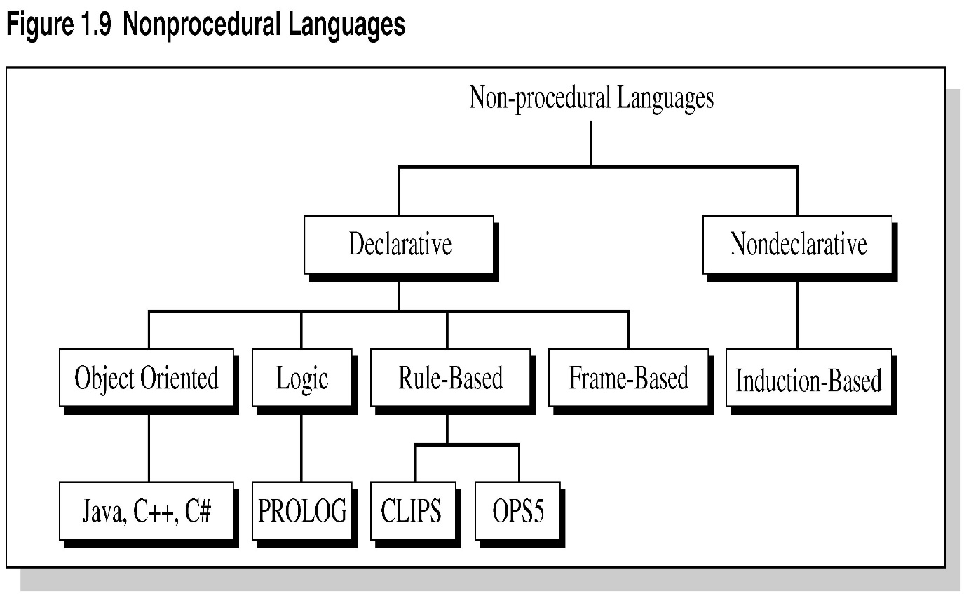
FIGURE 1.9 NONPROCEDURAL LANGUAGES
Notes:
02.37.65

Slide 47
SUMMARY
During the 20th Century various definitions of AI were proposed.
In the 1960s, a special type of AI called expert systems dealt with complex problems in a narrow domain, e.g., medical disease diagnosis.
Today, expert systems are used in a variety of fields.
Expert systems solve problems for which there are no known algorithms.

Slide 48
SUMMARY CONTINUED
Expert systems are knowledge-based – effective for solving real-world problems.
Expert systems are not suited for all applications.
Future advances in expert systems will hinge on the new quantum computers and those with massive computational abilities in conjunction with computers on the Internet.

